Slide 1
Naïve Approach

Slide 2
What is Naïve Approach?
It describes a primitive programming style, one in which the programmer relies on the computer's processing power instead of using corresponding Algorithms to simplify the problem, often ignoring problems of scale and applying naive methods suited to small problems directly to large ones. In simple words it describes all the possibilities.

Slide 3
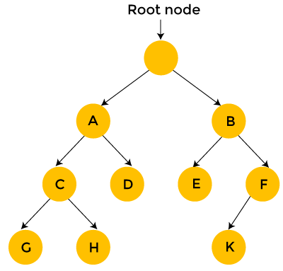
Visual representation
Indeed, Naïve Approach search can be viewed as the simplistic. It should not be confused with backtracking, where large sets of solutions can be discarded. The Naïve Approach solution is simply to calculate the total distance for every possible route and then select the shortest one.

Slide 4
Naive Approach in my code
1. The Naïve Approach function-The input is the list of permutations, the dictionary of applicants and the dictionary of jobs. We then loop through the permutations, for each row of the permutations. Then apply the utility function.

Slide 5
Naive Approach in my code
2. The Utility function- receives as input the current permutation and both dictionaries and returns as a result the total utility for the current permutation. We loop through the current permutation for each element of it, calling the fitting value function and adding the result to the sum it will return

Slide 6
Naive Approach in my code
3. The Fitting function- takes the current applicants and job dictionaries at the input, and it will return a fitting value which is the product of both dictionaries applicants and jobs.

Slide 7
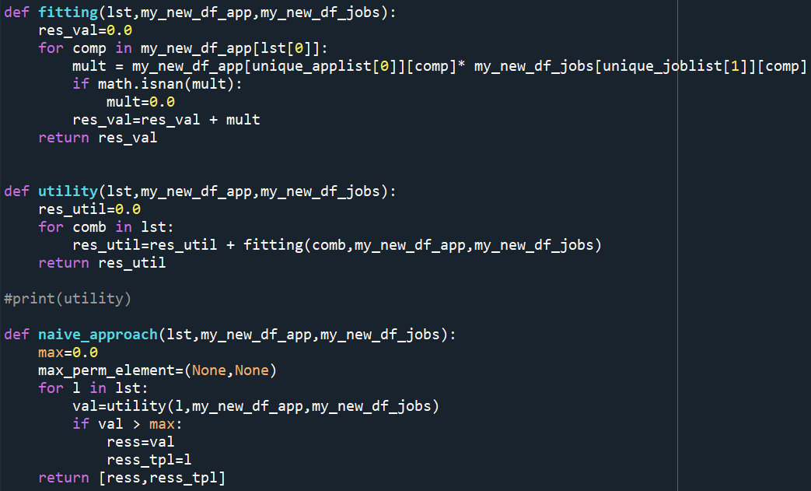
Visual representation of the code

